Slide 1
Apple Store
Project II
by Sabina Shahbazzade

Slide 2
Questions:
Top 10 popular applications downloaded by people ratings
Most 5 weighted applications
Least 5 weighted applications
Top 5 most expensive applications
The top one application people download by genre

Slide 3
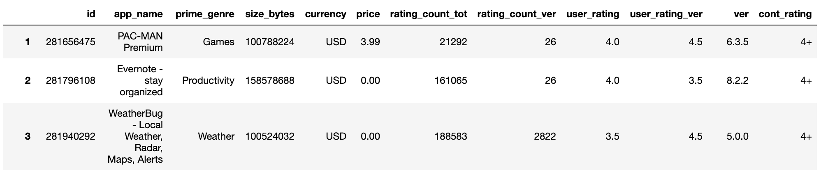
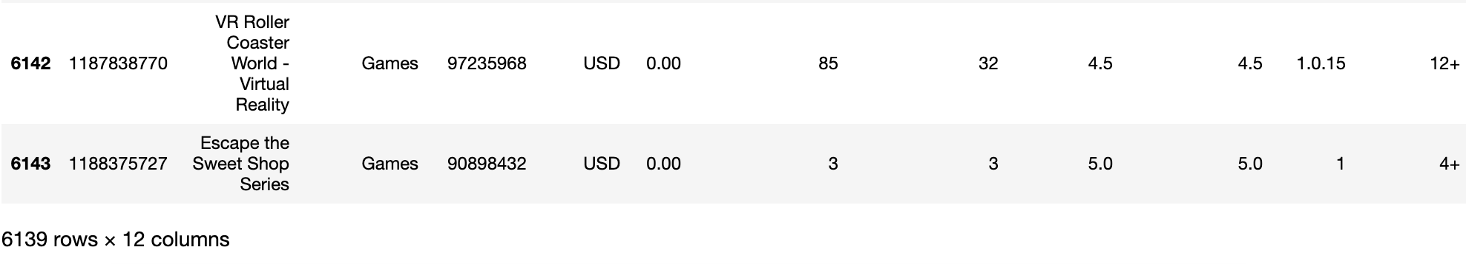
Apple Store Dataset

Slide 4
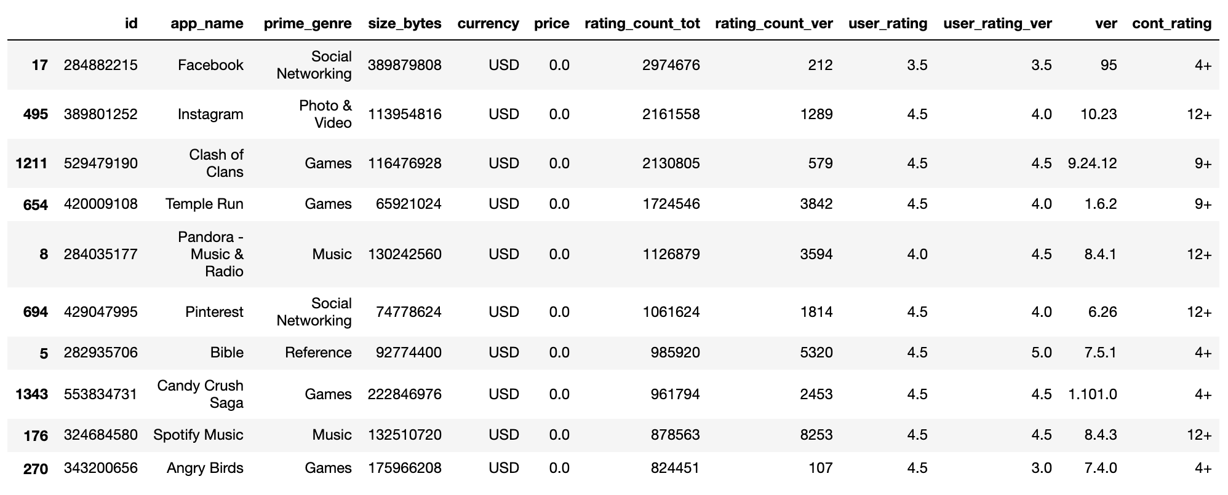
Top 10 popular applications downloaded by people ratings

Slide 5
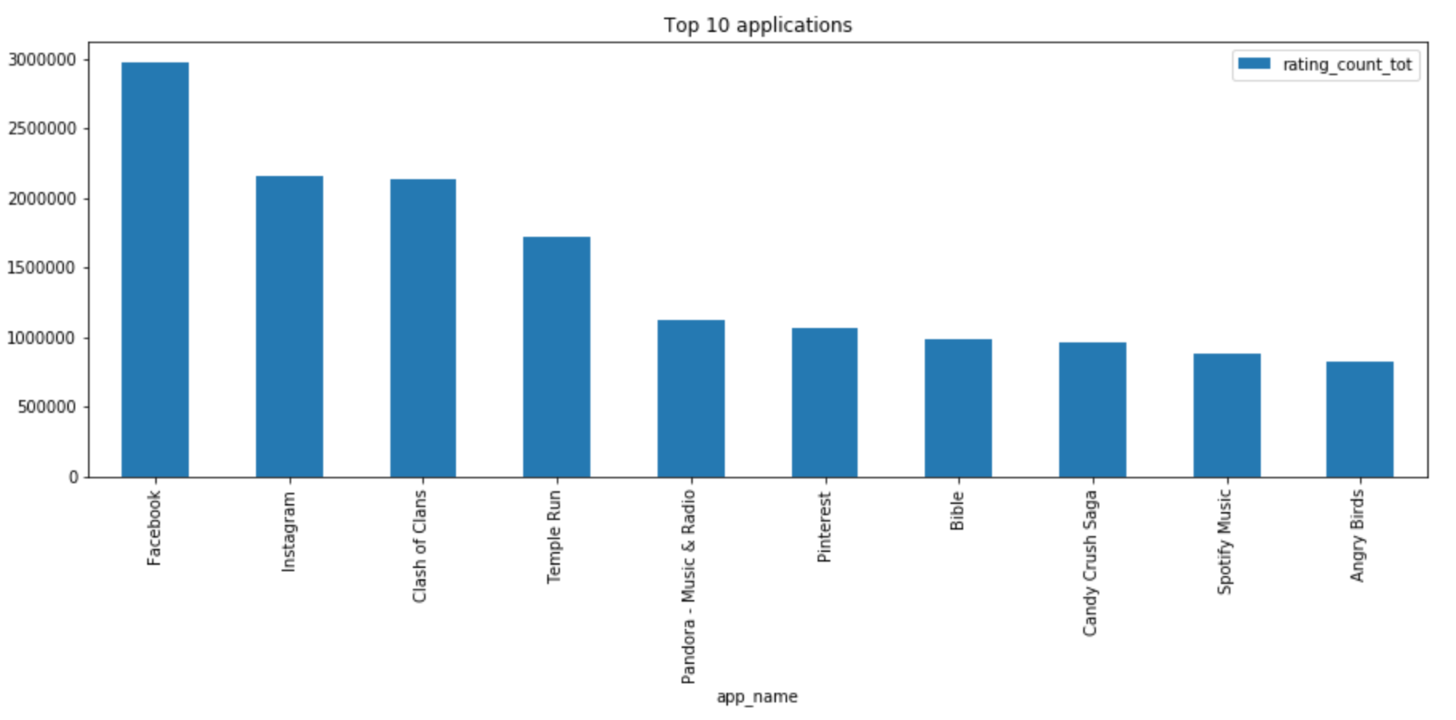

Slide 6
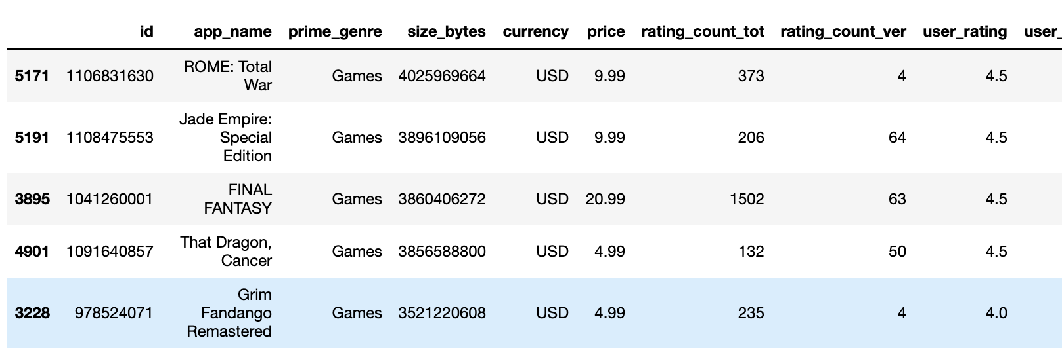
Most 5 weighted applications

Slide 7
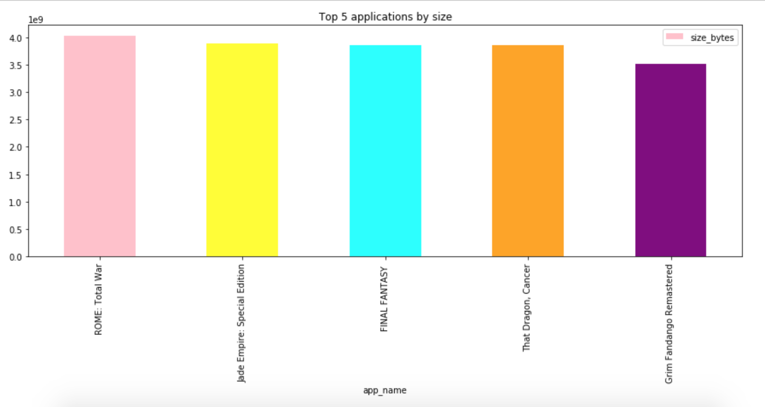

Slide 8
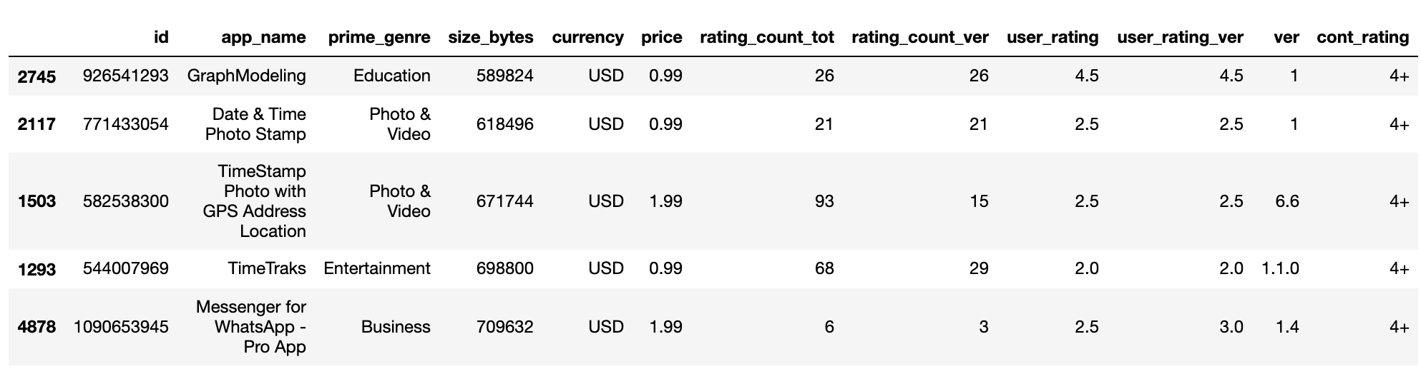
Least 5 weighted applications

Slide 9
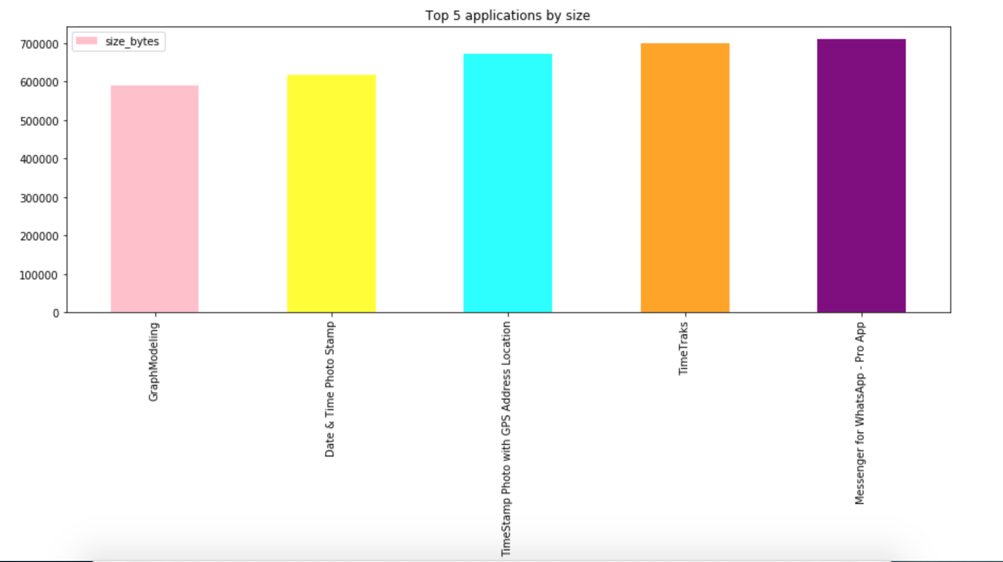

Slide 10
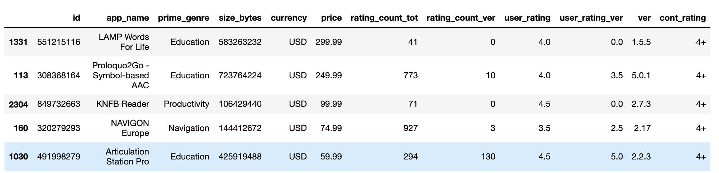
Top 5 most expensive applications

Slide 11
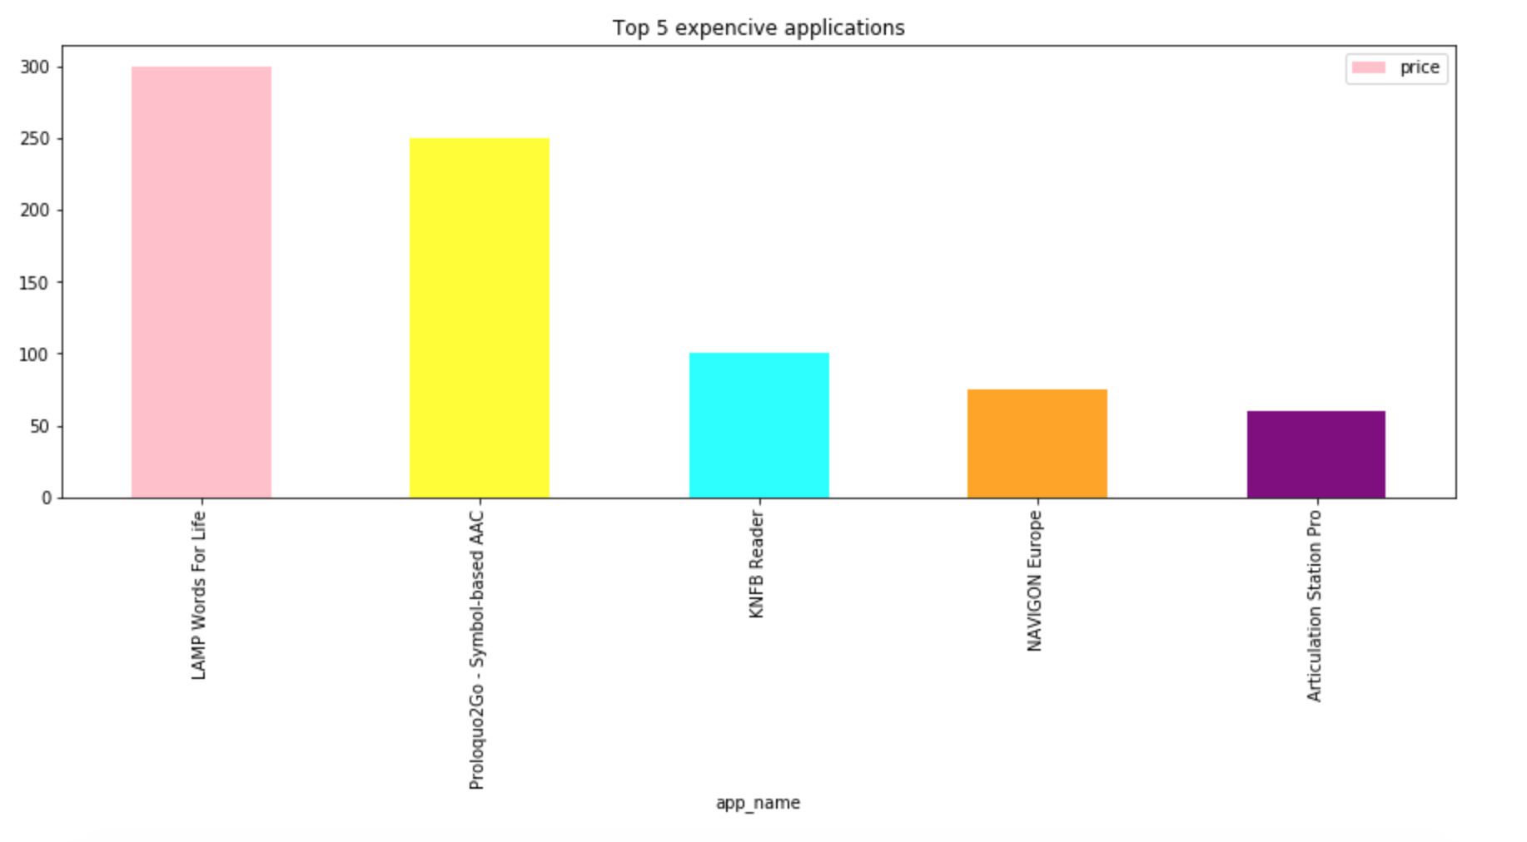

Slide 12
The top one application people download by genre mostly

Slide 13
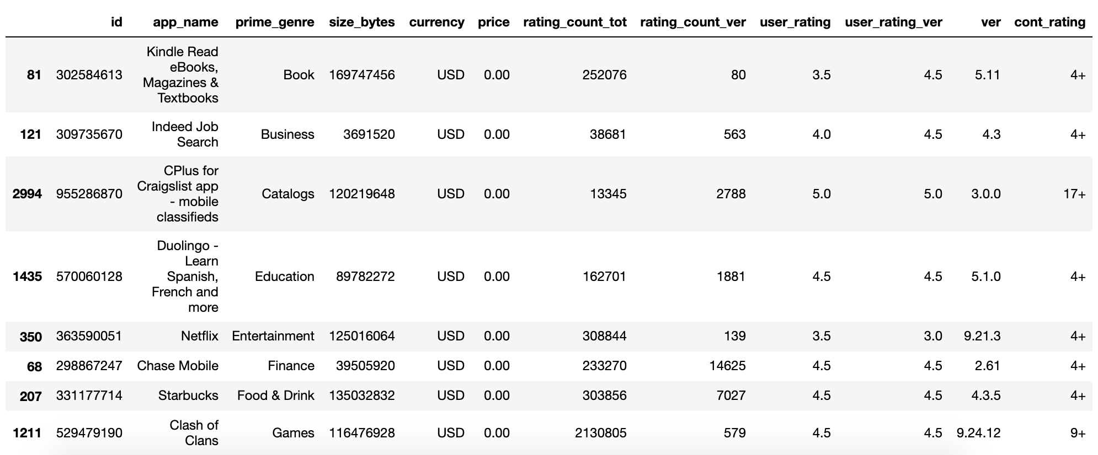

Slide 14
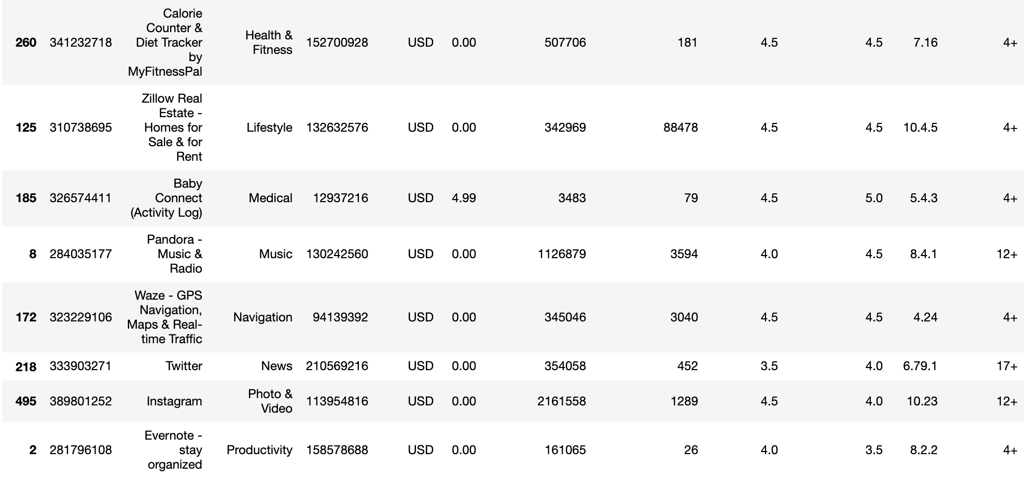

Slide 15
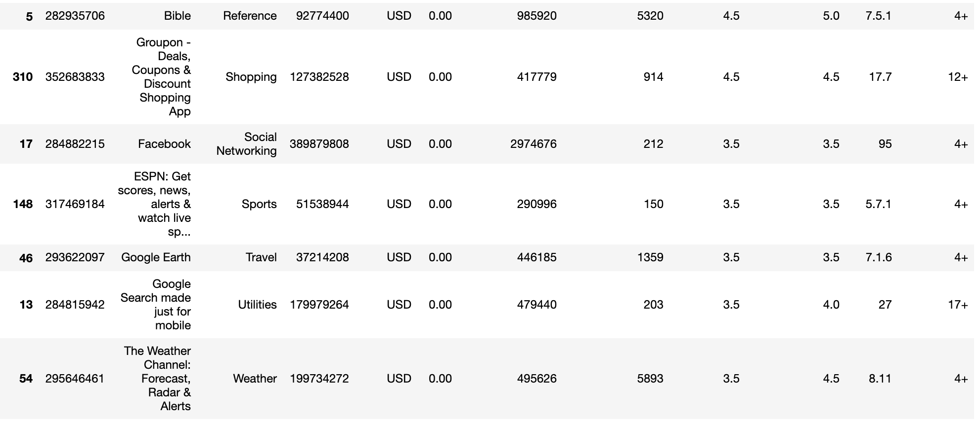

Slide 16
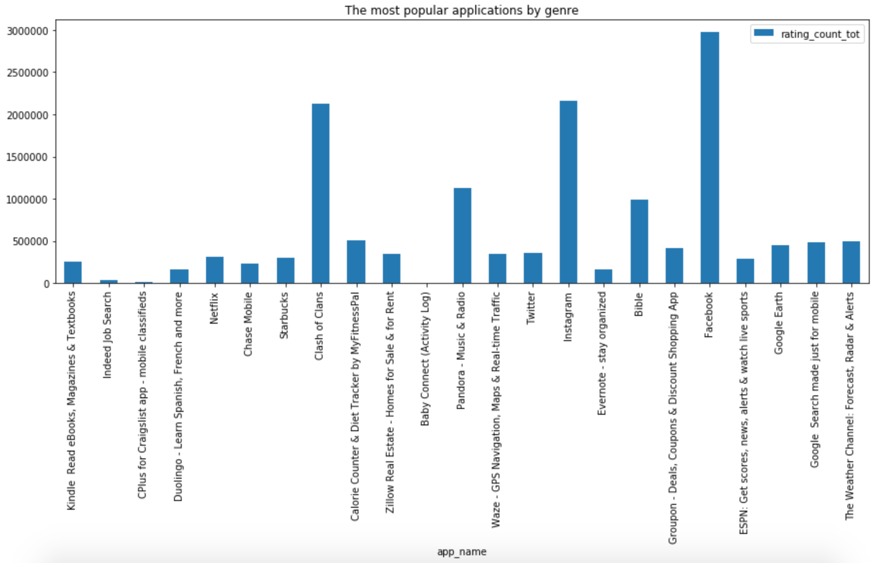

Slide 17
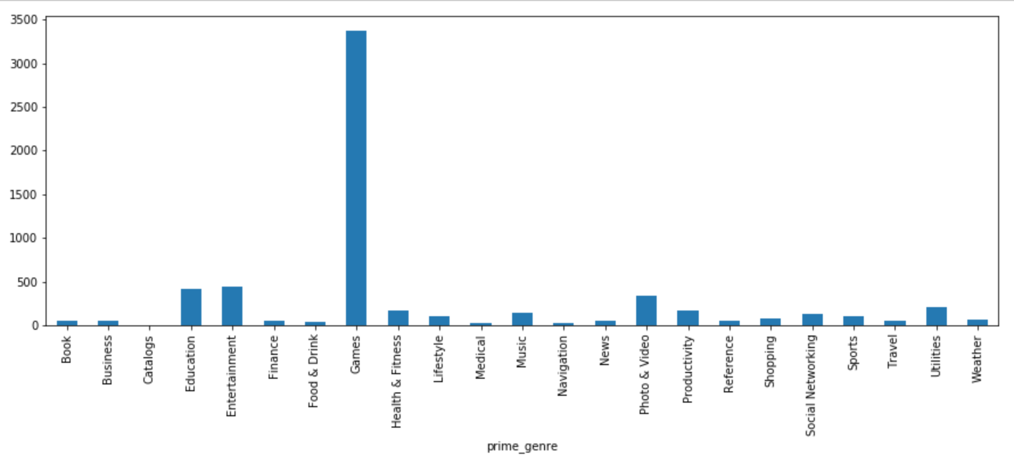
Popular Genres

Slide 18
Resources:
Original data: https://www.kaggle.com/ramamet4/app-store-apple-data-set-10k-apps/

